Slide 1

Troy School District
Board of Education Workshop
October 7, 2025

Slide 2
Agenda
Michigan Department of Education Continuum of Programs and Services- Focus on LRE
Special Education Department Overview
  Continuum overview
  Birth-age 26 Service Providers
  Special Education Programming
  Early Childhood Data
  Out of District Student Data
Disability Trend and Move-In Data
Parent Advisory Committee
2025-26 Focus Areas
Budget

Slide 3
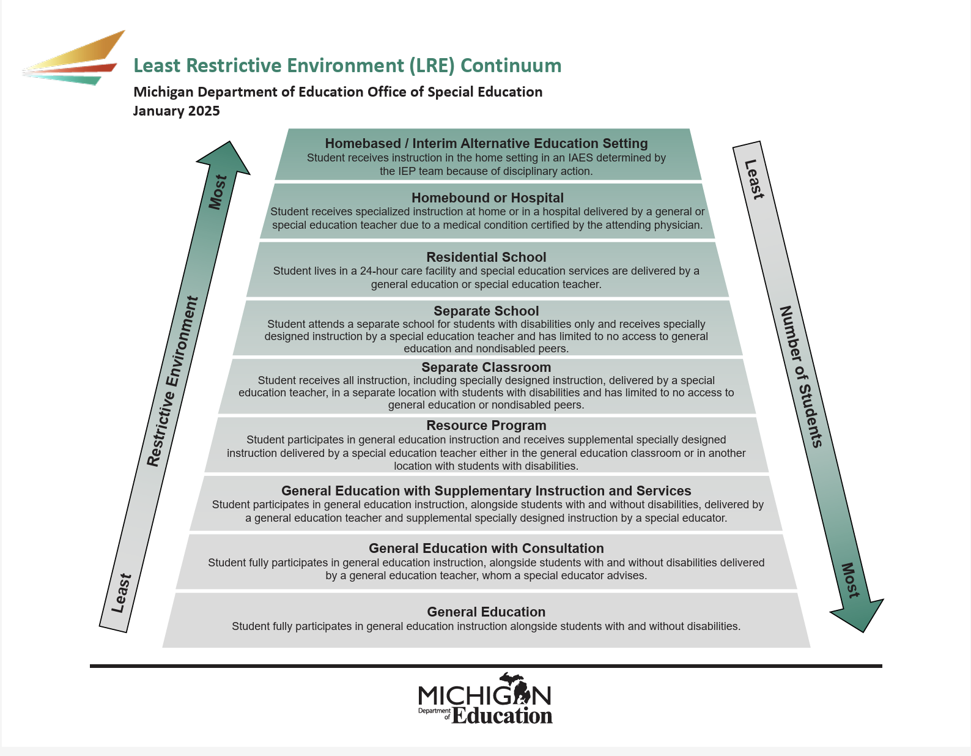
Continuum of Programs and Services-
Notes:
to the maximum extent appropriate, children with disabilities, including children in public or private institutions or other care facilities, are educated with children who are nondisabled; and
(ii) special classes, separate schooling or other removal of children with disabilities from the regular educational environment occurs only if the nature or severity of the disability is such that education in regular classes with the use of supplementary aids cannot be achieved satisfactorily

Slide 4
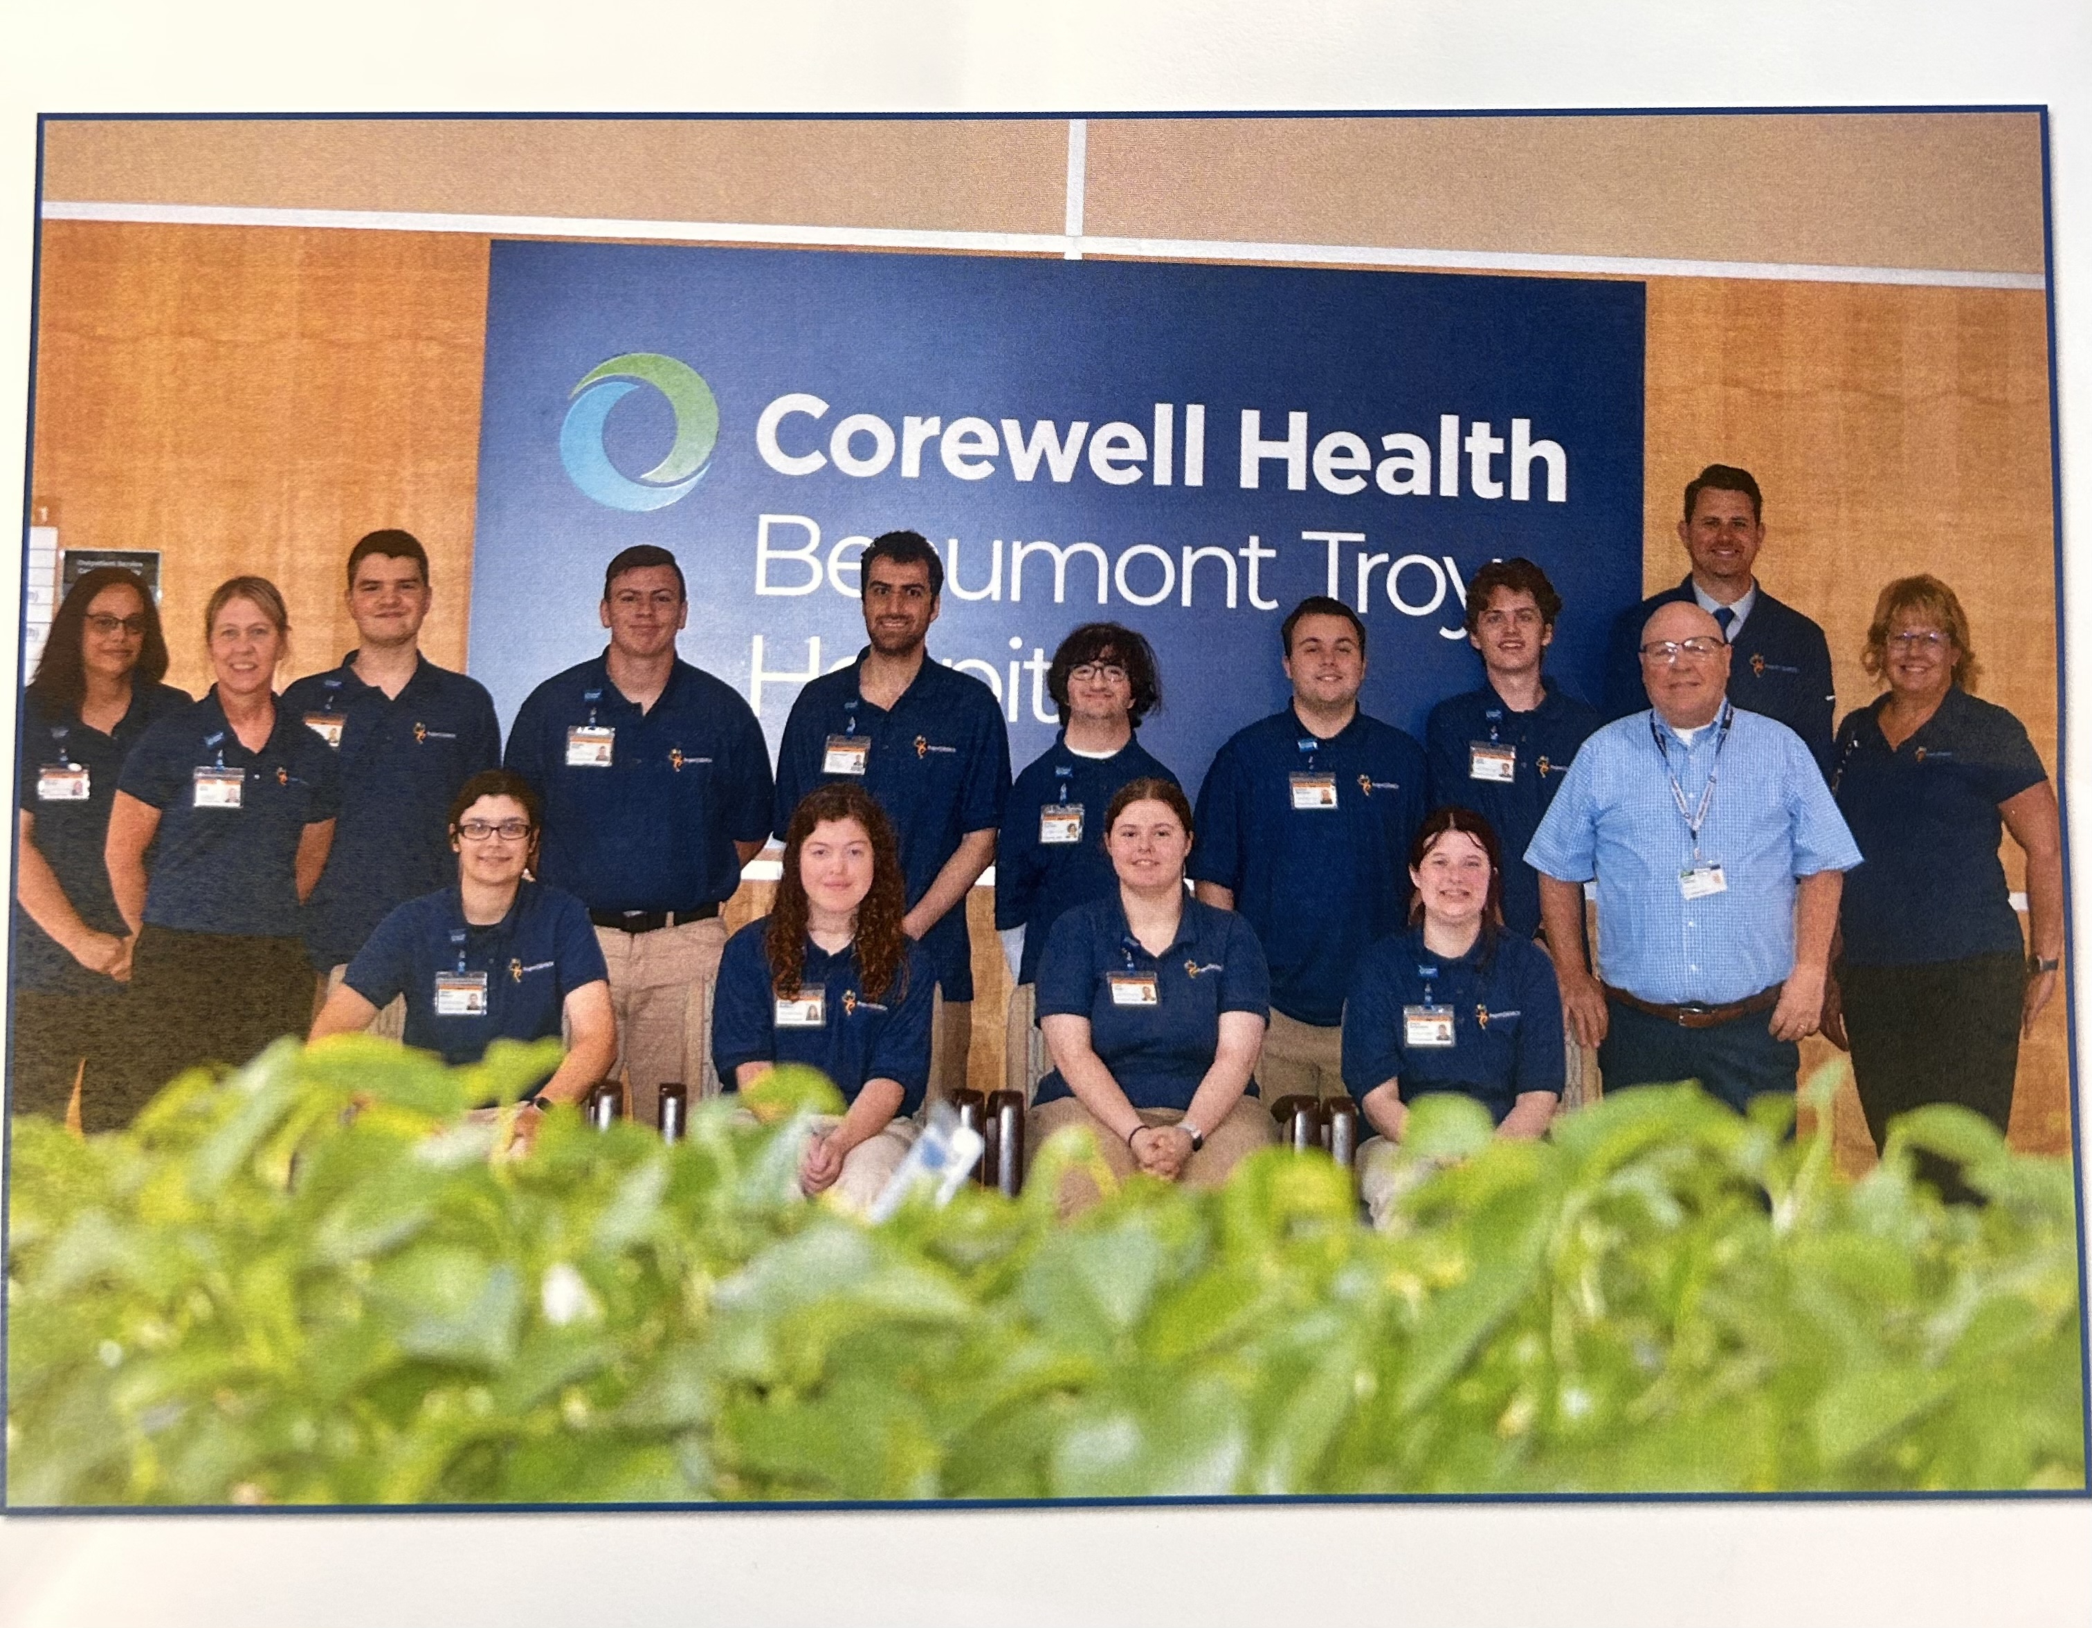
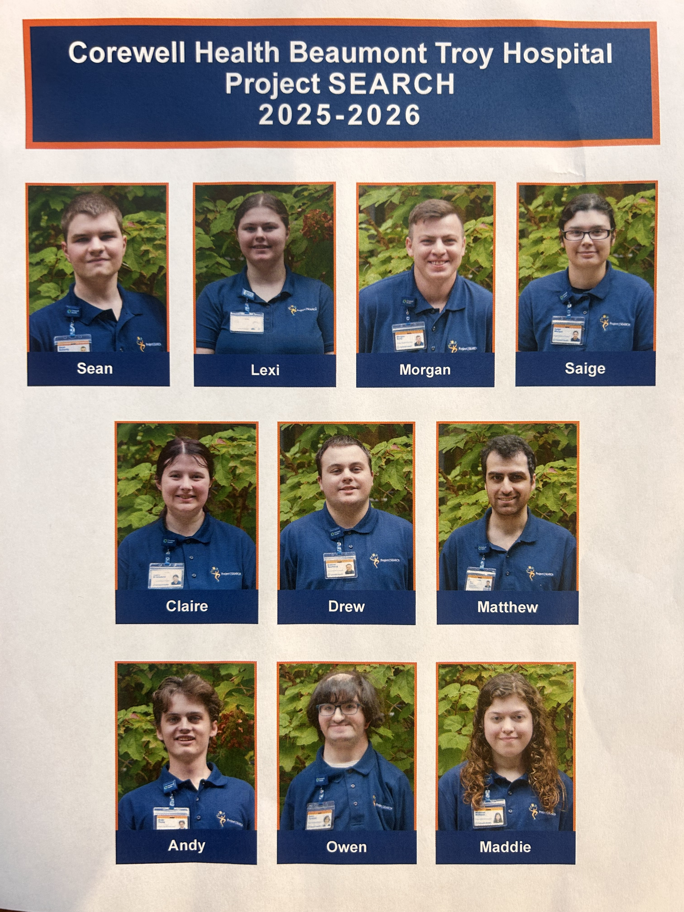
Special Education Continuum Overview
Troy School District provides a full continuum of programs and services for students, birth-age 26
2024-25 data- 1367 students with Individualized Education Programs
Birth-age 3- Individual Family Service Plan (IFSP)
  Age 3 – 26- Individual Education Program (IEP)
  Age 3-12th grade- Services only (SSW, SLP, TC, OT, PT)
Resource Room Program Placement- K-12
Categorical Program Placement – Preschool - age of 26
  FTE- 44.0 program teachers (preschool-Troy Center for Transition)
Homebound Services
Project Search- 1 program

Slide 5
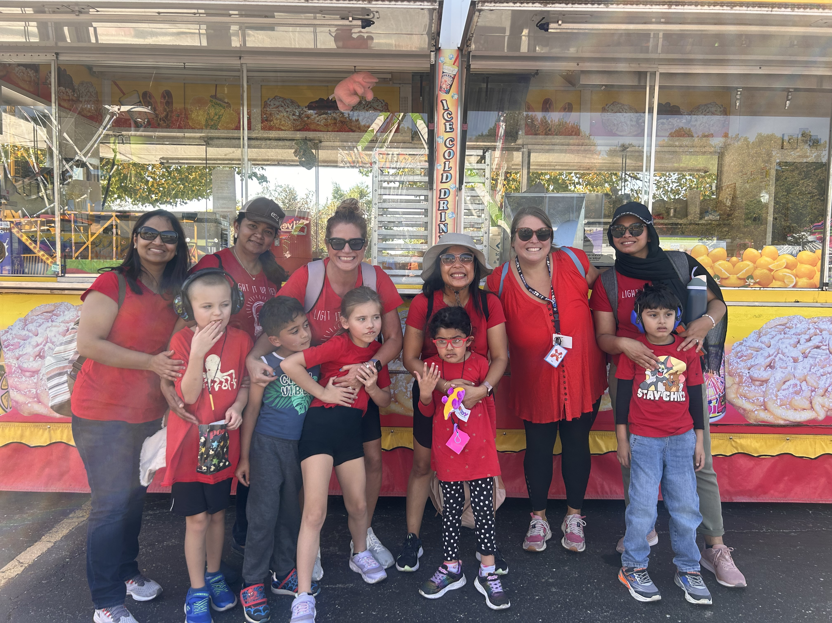
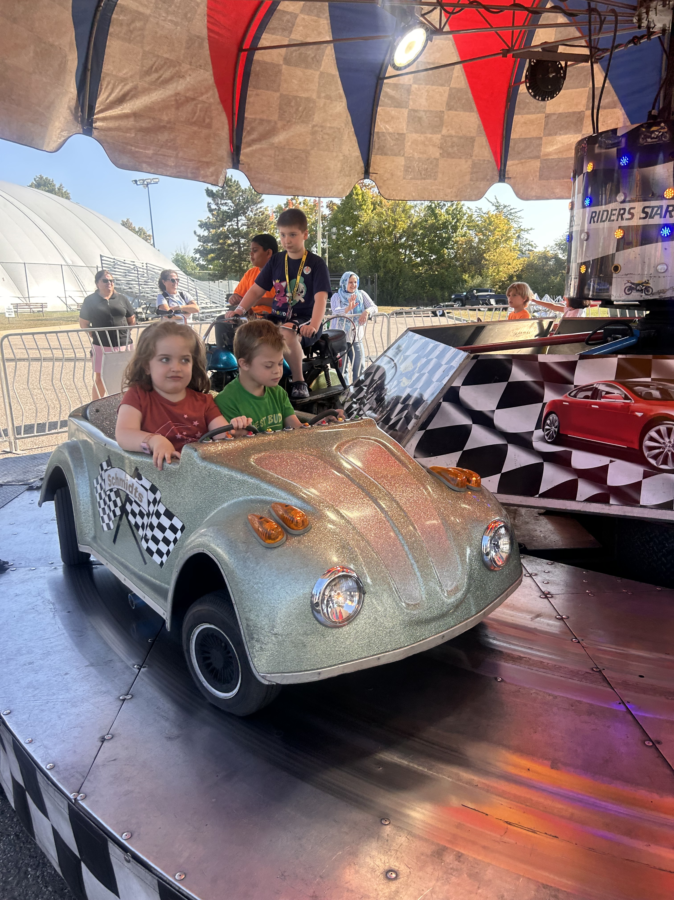
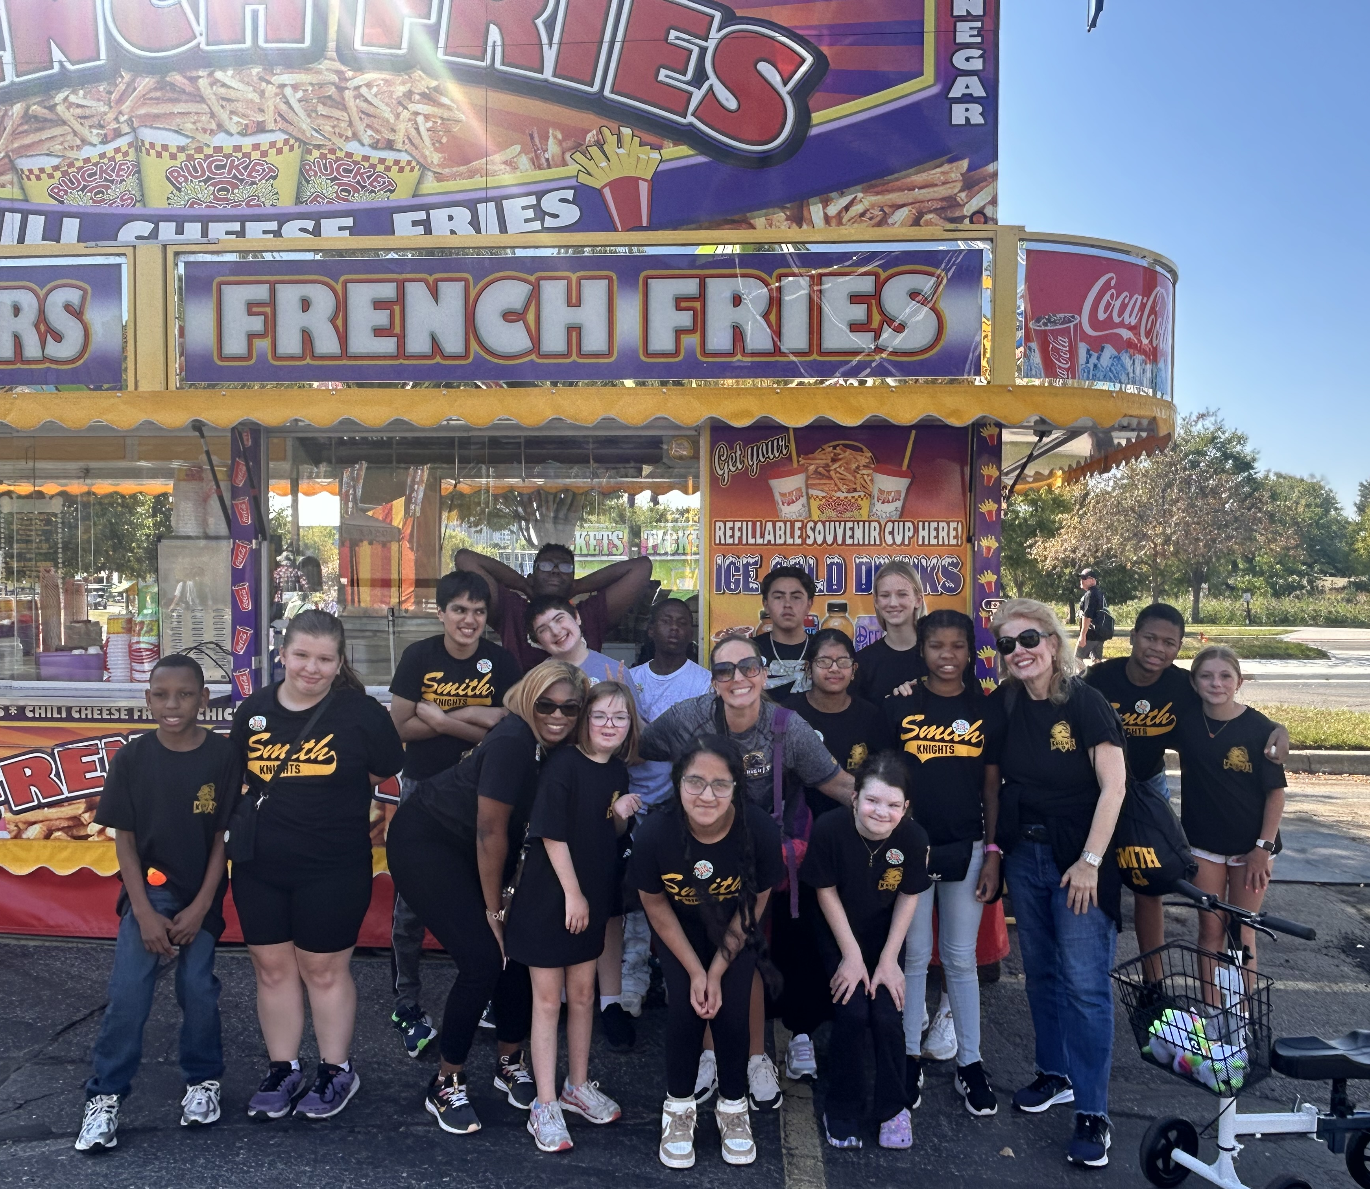
Special Education Categorical Program Overview
Early Childhood SE (ECP)-8 sections, 4 teachers
Mild Cognitive Impairments-6 programs
Moderate Cognitive Impairments- 3 programs
Emotional Impairments – 3 programs
Level 3 Programs- 3 programs
Level 4 Programs- 20 programs (15 ele., 3MS, 2 HS)
Troy Center for Transition- 5 programs

Slide 6
District Service Providers - Birth-26
Our Ancillary Team
26 School Social Workers
22 Speech and Language Pathologists
10 School Psychologists
23 Teacher Consultants
7 Occupational Therapists, 2 Physical Therapists
7 Early On Team Members
Assistive Technology Consultant
BCBA & BCaBA (31n grant positions)
  Two Behavior Specialists
  Six Behavior Support Technicians
Non-Public Service Team
Two Homebound Teachers
Special Education Leadership Team:
Allison Mason- Special Education Early Childhood Coordinator
Chris Olson- IEP Quality and Compliance, SSW
Erica Conklin-Behavior Support Coordinator
Teresa Bruno-Troy Center for Transition Coordinator
Zach Downer- Transition Coordinator
District Support Staff FTE:
Para-educators/program assistants-100
Student support aides- 152
Job Coaches- 11
Notes:
Hillary

Slide 7
District Data- birth through age 5
Birth - Five | 2022 Children | 2025 Children
Early On (Birth – 3) | 33 families | 38 families
Early Childhood Program (ECP) (2 ½ - 5) (2023-2024 SY-increased in 1 teacher FTE) | 50 | 62
1755 Program-(ages 3-5)-students receive services (2-5 hours per week) in the natural preschool environment | 12 | 18
Itinerant Speech | 59 | 54
Notes:
Hillary

Slide 8
District Data: Out of District Data
Center program placement-county programming for students with the most complex medical, physical, and behavioral needs
Wing Lake -Supports students with severe multiple impairments (SXI)
Deaf and Hard of Hearing (DHH) Programs
Segregated programs for students with emotional impairments or significant autism
 | 2009-10 | 2014-15 | 2019-20 | 2025-26
Center program placement | 90 | 61 | 39 | 21
Notes:
Hillary

Slide 9
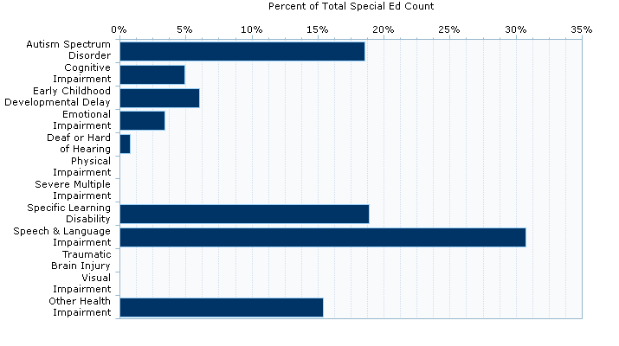
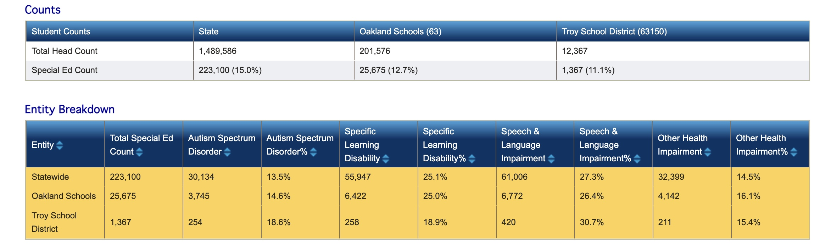
Disability Eligibility Data
Notes:
Jamie

Slide 10
Eligibility Over Time & Move In Data
2024-25 Students IEPs 1367 | 2014-15 | 2020-21 | 2024-25
ASD eligibility | 121/(10.6%) | 185 (14.6%) | 254 (18.6%)
Specific Learning Disability | 383 (33.7%) | 289 (22.8%) | 258 (18.9%)
Speech and Language Impairment | 307 (27%) | 417 (32.9%) | 420 (30.7%)
 | 2018-19 | 2020-21 | 2022-23 | 2024-25
Level 4 Programming Needs | 7 programs | 12 programs | 15 programs | 20 programs
2025-2026 transfer student's w/IEPs | Transfer students placed in categorical programs | Transfer students placed in Level 4 programs | New students in need of immediate evaluation for programming purposes
66 currently | 23 | 12 | 7
Notes:
Jamie

Slide 11
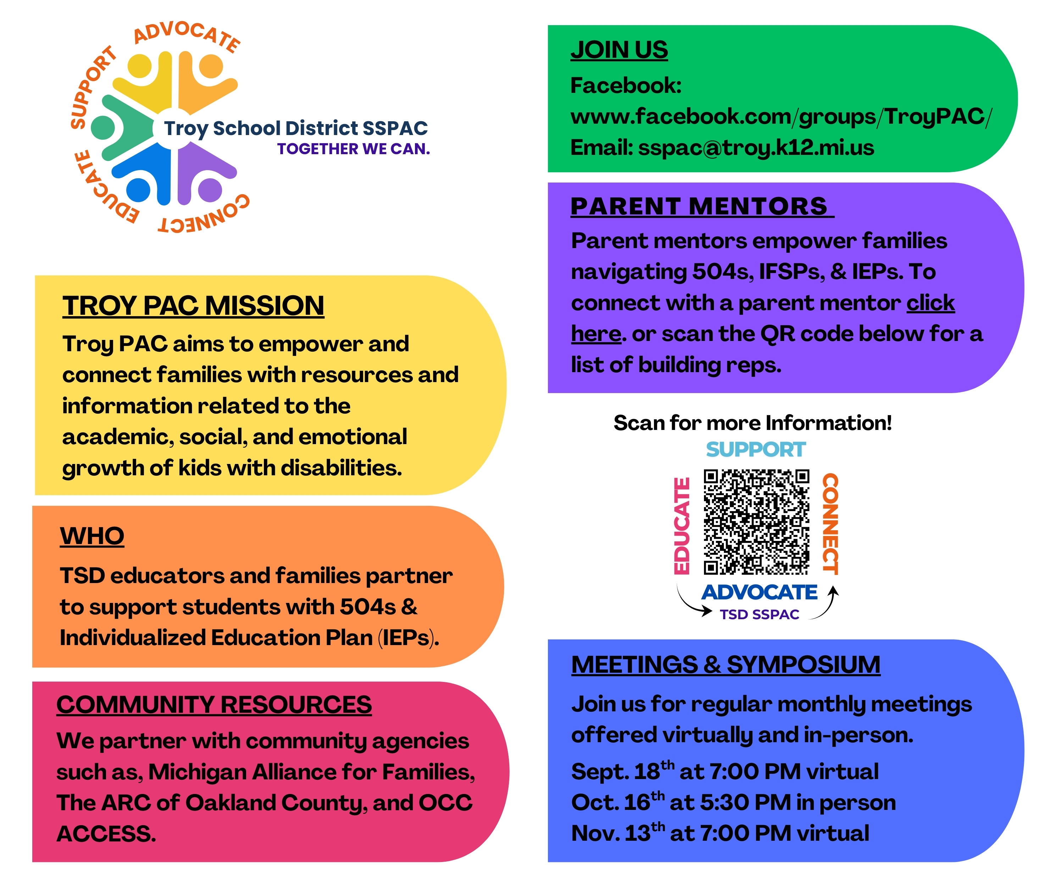
Family Engagement:
Parent Advisory Committee
SSPAC Executive Board Members
Rebecca Gilkey
Reem Sater
Kate Wharton
Oakland County PAC Representative:
Reem Sater
Building Representatives
Selected by Building Principal/TEAM
Serve as a resource for families at the building level
Attend Monthly meetings
Participate in and/or contribute to scheduled PAC events
Convey information and distribute event flyers to their building
Attend PTO Meetings when possible
Stay informed and promote PAC activities
Notes:
Jamie

Slide 12
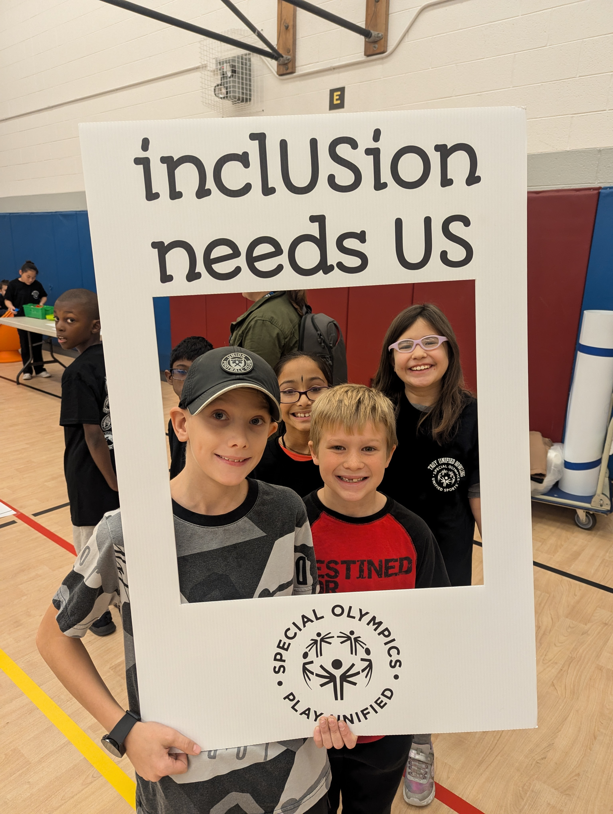
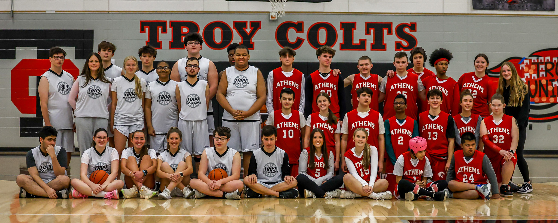
2025-2026 Goals and Focus
Ensure that all students, regardless of ability, have equitable access to high-quality instruction and supports by fostering inclusive practices across all learning environments
Continued alignment and collaboration with Teaching and Learning related to MTSS, special education programming, and professional learning in intensive intervention delivery to ensure measurable progress for all students
Ensure students with complex needs are supported effectively through individualized, evidence-based practices, strong collaboration among staff and families, and continued inclusive opportunities that promote academic growth, communication, independence, and social belonging.
Increase family engagement, support, and resources through the PAC

Slide 13

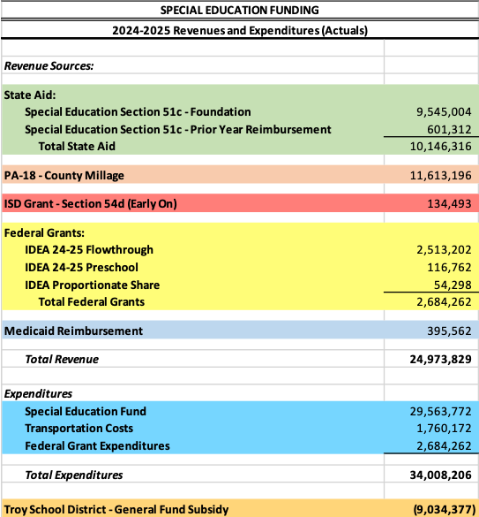
Special Education Funding
Notes:
2018-19- 8.2

Slide 14
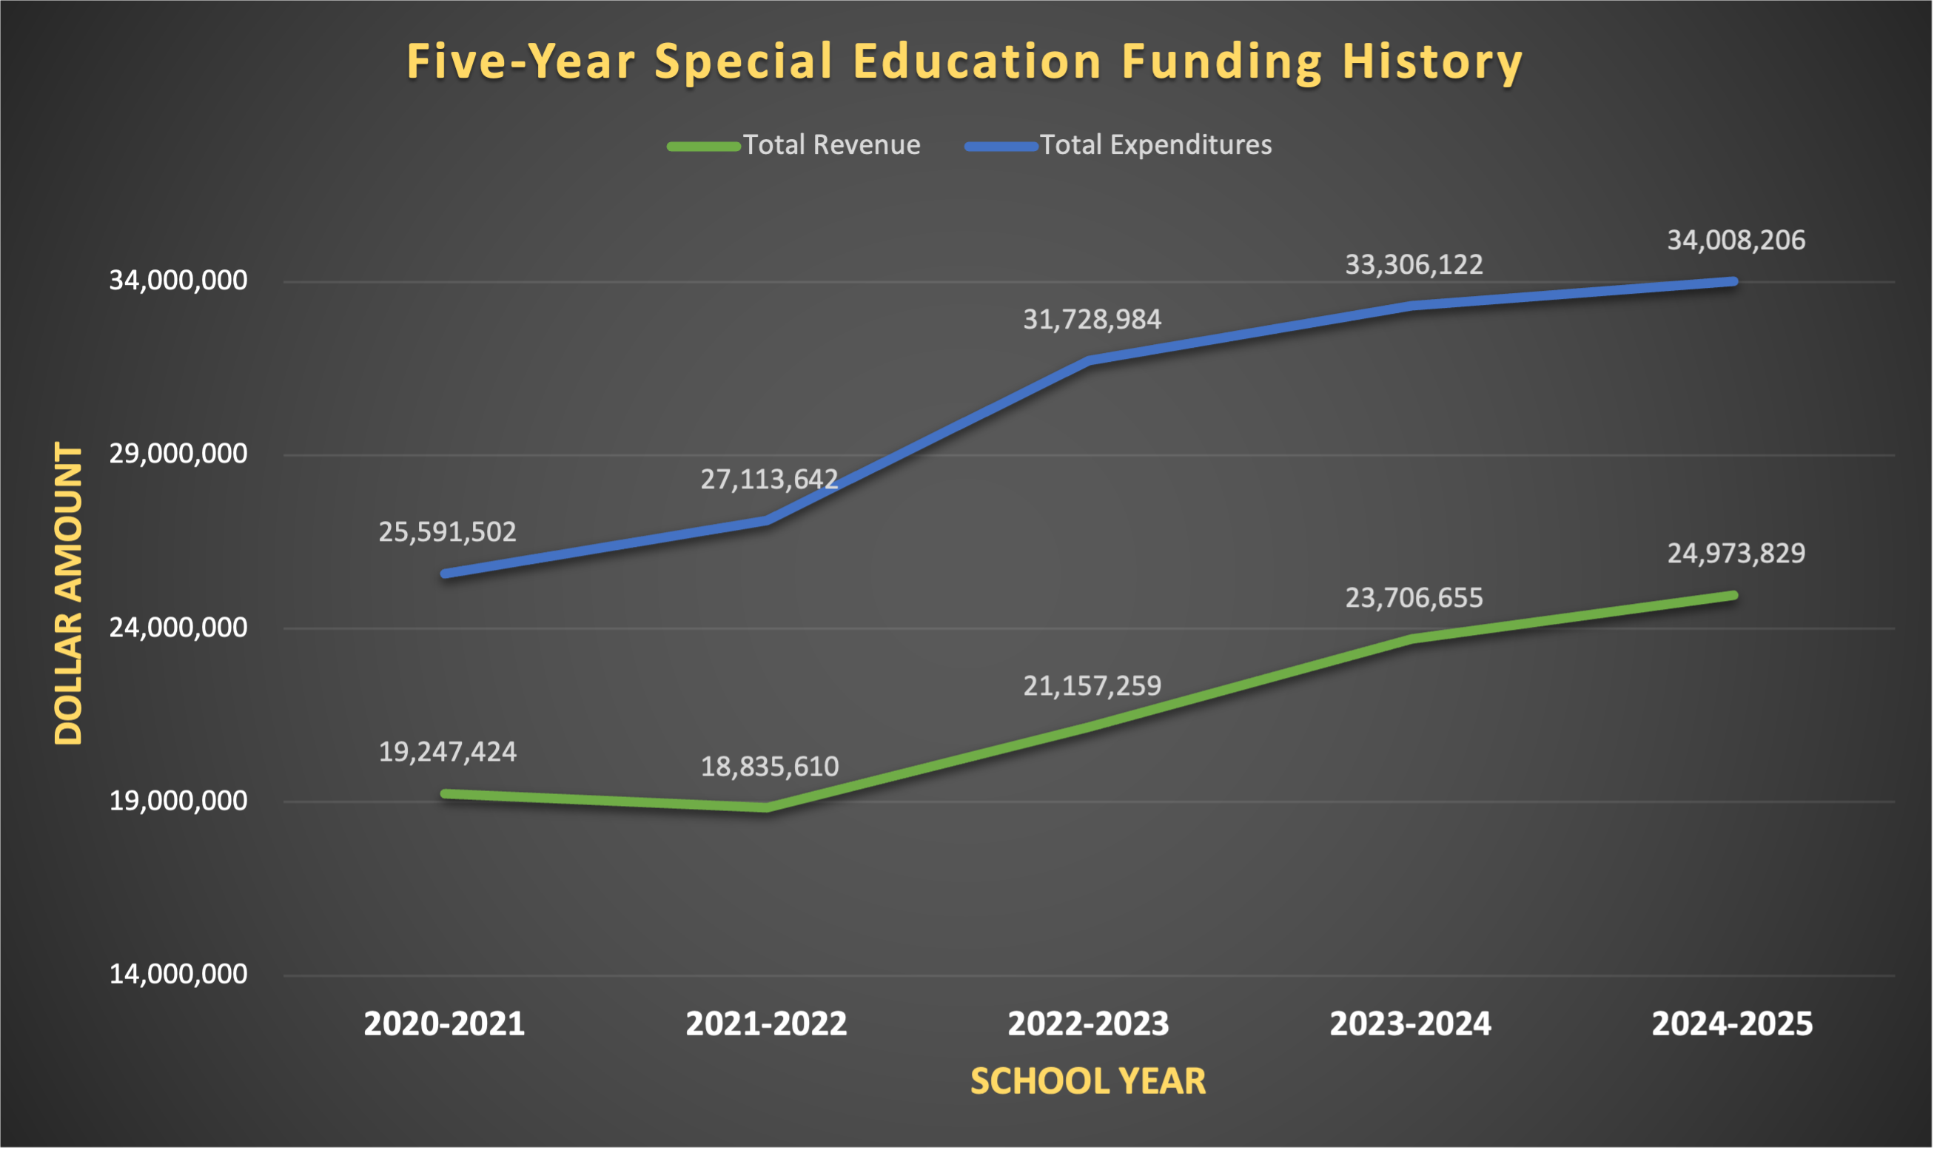
Notes:
2018-19- 8.2

Slide 15
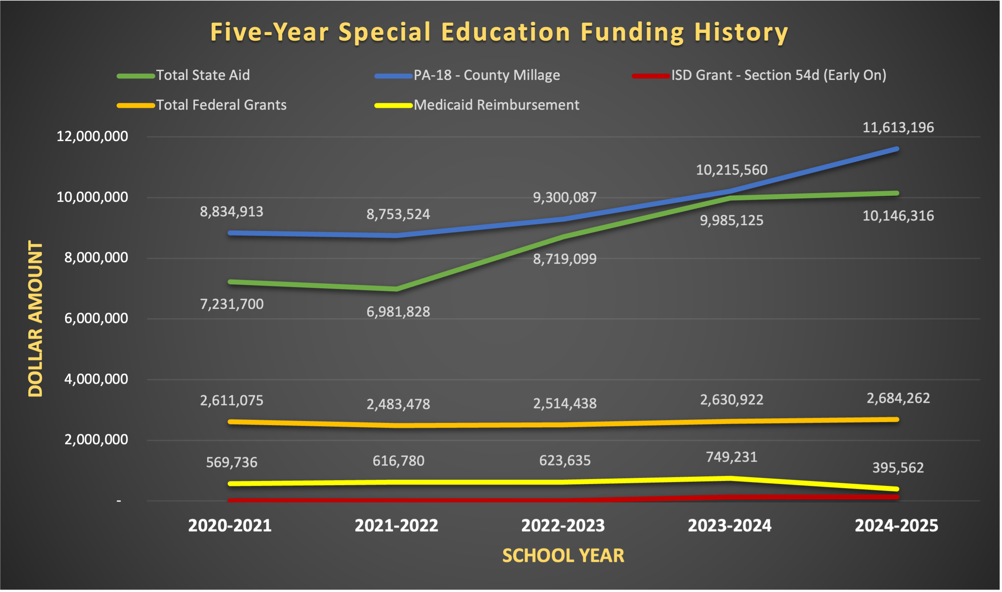
Notes:
2018-19- 8.2

Slide 16

Questions

